Slide 1



1Scope Growth Project
BusinessOne Consulting
Rajeev Casinader, David Chen, Raymond Cheng, Annabelle Jenkins, Michelle Jusmin, Louise Li & Venkatesh Vasudevan

Slide 2
1Scope
1Scope is an EduTech startup which aims to provide students with access to career specific events and opportunities.
1Scope proposes value to businesses by opportunity posting, evaluation and event management.
Their website offers a range of different types of opportunities:
Workshops and programs
Students can apply for opportunities & experiences available at major companies, top universities & non-profits.
Work placement
Information events

Slide 3
Project Overview
Needs more user sign ups
Lack of user connection to brand
Situation
How can 1Scope develop its user acquisition strategy to foster significant user base growth?
Key Question
Develop
Renew
Solutions
New methods should be tested to increase signups, focused on connecting consumers to 1Scope's value proposition
Target students at their key moments
1Scope should organise and run events
1Scope current marketing efforts can be augmented to align with new strategies
Move majority of advertising to social media
Have workshops related to current student situations
Recommendation

Slide 4



A clear marketing strategy and value proposition can help foster connection with 1Scope brand
Marketing Strategy
Gain exposure
Create online presence
Increase brand awareness
1Scope will be able to increase their user acquisition through identifying the needs of specific target markets and marketing to them accordingly

Slide 5



We have developed key outcomes to achieve through addressing the need for connected signups
1
2
3
Effective Engagement methods
Maximise targeting of entire target market
Analytics for improving and refining
Using social media to its fullest extent
Targeting students both physically and online
Developing a larger social media presence
Targeting both ends of the target market (12 and 25)
Tailor events more specifically towards each particular segment of the age groups
Using analytics tool trackers to track campaigns
Using data to refine marketing strategies continuously
Improving current strategies with statistics

Slide 6
New methods should be tested to increase signups, focused on connecting students to 1Scope's value proposition
Successful customer-experience efforts apply a human filter to the collected data to ask overarching questions.
Increasing student connection with 1Scope’s value proposition, vision and branding will increase signups.
New methods should be tested on 30 to 90 day cycles.**
Value Proposition
1
Bridging the information gap between study and work
4
Range of opportunities
Informing unaware students
Information taught beyond school curriculum
2
5
One stop shop
Discover and pursue new opps.
3
6
*Source: McKinsey, 2016
**Source: Startup Marketing
Notes:
Venk: Bridging the information gap
B2C : Giving you experience to bridge the gap between studying and working
Raymond: students are lost.
B2C: Discover new pathways and get a headstart on your career by using this platform to easily discover, access and attend professional events and workshops.
David: Everything is brought into one place: one stop shop
B2C: A website where you can discover new opportunities and develop new skills on a centralised, easy to use online platform.
Michelle: Wide target range and range of opportunities
B2C: A platform where you are exposed to a diverse range of opportunities and find out where your interests truly lie
Annabelle: Access to information taught beyond school curriculum
- B2C: Giving you an opportunity to gain experiences beyond your normal school program.
Rajeev: Pinterest board of opportunites, ability to discover and pursue new opps.
B2C: Differentiate between opportunities, discover new skills.

Slide 7
1Scope should pursue sign up strategies which will be consistent and include connection to the brand
Develop
‘Big Moment’ Marketing
Systematic Social Media
On Campus Marketing
Target students during the key moments of their lives
A consistent social media strategy aligns with student habits.
Increase 1Scope’s brand presence on university campuses.
New Product Offerings
1Scope Run Events
New products could appeal to different market segments
1Scope run events will increase interest and signups.
Renew
Partnership Strategies
Connect B2B to provide students with even better opportunities.

Slide 8
Recommended strategies will work in tandem with each other to increase impact and efficiency.
Big Moment Marketing
+
On Campus Marketing
Social Media
Ambassador Program
Unique Opportunities
1Scope Run Events
Partnership

Slide 9
Strategies which require less manpower and technical difficulty should be proritised.
Solution Feasibility Matrix
1
‘Big Moment’ marketing
2
Systematic social media
5
3
On campus marketing
Technical Difficulty
2
4
New product offerings
1
6
3
5
1Scope run events
4
6
Partnership strategies
Labour Intensiveness

Slide 10



Develop

Slide 11
1Scope should pursue sign up strategies which will be consistent and include connection to the brand
Develop
‘Big Moment’ Marketing
Systematic Social Media
On Campus Marketing
Target students during the key moments of their lives
A consistent social media strategy aligns with student habits.
Increase 1Scope’s brand presence on university campuses.
New Product Offerings
1Scope Run Events
New products could appeal to different market segments
1Scope run events will increase interest and signups.
Renew
Partnership Strategies
Connect B2B to provide students with even better opportunities.

Slide 12

Aligning 1scope’s marketing efforts with key moments in a student’s life will have a more significant impact
80%
65%
88%
16%
Declining importance of humour being important in advertising
88% of students are more responsive to brands that give back to the community i.e. have some impact on their lives
16% of young people’s time is spent online consuming social media including advertising
In any students’ life there are certain moments that will impact them the most e.g. first day of university, graduating high school etc.
Creating value adding events that are able to associate the brand and its activities with these moments will be remembered the most.
By tailoring new events towards the key moments of a students life 1scope is able to impact students the most
Source: Adweek.com

Slide 13








Key moments of High School and University students
High School Students
1
2
First weeks of school
Work Experience
1scope can provide a how to start guide for high-school students
Provide advice, guides or networks for students to do work experience
3
4
HSC examinations
Graduation
Provide how to guides on how to tackle exams effectively
Next steps to complete, how to get a job, travelling ideas
University students
1
2
First weeks of University
First exam period
Advice on getting involved/ help with transition to University
Online crash courses for core subjects, study guides
3
4
Internship season applications
Graduation
How to apply for internships, resume and cover letter advice, LinkedIn profile advice
Next steps, transitioning out of University

Slide 14
1Scope should pursue sign up strategies which will be consistent and include connection to the brand
Develop
‘Big Moment’ Marketing
Systematic Social Media
On Campus Marketing
Target students during the key moments of their lives
A consistent social media strategy aligns with student habits.
Increase 1Scope’s brand presence on university campuses.
New Product Offerings
1Scope Run Events
New products could appeal to different market segments
1Scope run events will increase interest and signups.
Renew
Partnership Strategies
Connect B2B to provide students with even better opportunities.

Slide 15



Systematic marketing will involve 1Scope implementing three structured marketing campaigns
Facebook
Continue frequent posting promoting their events.
Integrate 1Scope’s ethos and identity into each post.
Implementation of “big moment” marketing.
Instagram
Link posts to 1Scope events.
Focus on streamlining user signup from Instagram posts.
Introduce cross-platform promotion.
Snapchat
Live, in-the-moment visual marketing at events.
Effective, 10 second snippets.
Introduce tours and walkthroughs.
Notes:
81% of consumers use FB on their smartphone
Flow is an audience-targeting tool by Driftrock designed to sync with your existing CRM or ecommerce platform and pull in customer data that will help you target your existing customer base more fully and accurately. You can focus on your existing customers and mailing list, or find new people who share similar characteristics with your current customer base and uncover new leads and prospects.
Google Analytics is mainly a tool to track web traffic, but if you aren’t using it in conjunction with your Facebook marketing campaign, you’re missing out. Here, you’ll be able to see exactly which links brought Facebook users to your site, and what they did when they got there. It’s perfect for uncovering your true ROI and determining the effectiveness of your website layout.
Real Geeks’ Facebook marketing tool was developed with real estate agents in mind. The tool syncs with an external website, draws in key pieces of information to create new Facebook ads on the fly, and saves all the time that would ordinarily be spent mostly in the manual labor of ad creation. It also has a number of analytic functions, so users can determine which ads are most effective … and tailor their future strategies accordingly.
Agora Pulse is a suite of tools in one that give you the chance to tie your Facebook, Twitter, Google+, Instagram, and LinkedIn accounts into one centralized location. You can schedule and publish posts, monitor social activity, engage in social listening, and even monitor your competitors.
Social Bakers is a social analytics app that works with almost any social media app you can think of. It will bring you competitive research, audience insights, KPIs, and other social data in customized reports you can tailor to your specific goals.
DrumUp is a combination content marketing and social media tool that helps you find the most appropriate and effective content topics your audience would appreciate. It functions as a content research and recommendation tool, in addition to giving you key insights about your social media strategy in general.
Likealyzer is a tool that empowers you to analyze the reach and effectiveness of your Facebook page. Plug in the URL of your page and the tool will tell you what, if anything, is wrong with your layout, and what kind of activity your page is seeing. Best of all? It’s free.
ShortStack is designed to make the ad and contest creation process easier for Facebook and other social media platforms. It features a friendly UI and dozens of tools to help you create the campaign you need.

Slide 16



Structed social media marketing will effectively engage a large audience of 1Scope’s target demographic.
Social media gives 1Scope access to a large market of our target demographic.
58% of all university students use Instagram.
83% of all university students use Facebook.
55% of all university students use Snapchat.
Social media is proven to be highly engaging amongst university students.
1 in 2 users check social media daily.
35% of all users check more than 5 times each day.
Facebook ads have a 8.1x higher click-through rate than regular web ads.
Social media marketing can effectively build a brand image for 1Scope.
Social media marketing will establish a consistent brand image.
A consistent brand image will increase familiarity and user engagement.
Effectively branded social media marketing is 2.9x more memorable than other online marketing.
Notes:
81% of consumers use FB on their smartphone
Flow is an audience-targeting tool by Driftrock designed to sync with your existing CRM or ecommerce platform and pull in customer data that will help you target your existing customer base more fully and accurately. You can focus on your existing customers and mailing list, or find new people who share similar characteristics with your current customer base and uncover new leads and prospects.
Google Analytics is mainly a tool to track web traffic, but if you aren’t using it in conjunction with your Facebook marketing campaign, you’re missing out. Here, you’ll be able to see exactly which links brought Facebook users to your site, and what they did when they got there. It’s perfect for uncovering your true ROI and determining the effectiveness of your website layout.
Real Geeks’ Facebook marketing tool was developed with real estate agents in mind. The tool syncs with an external website, draws in key pieces of information to create new Facebook ads on the fly, and saves all the time that would ordinarily be spent mostly in the manual labor of ad creation. It also has a number of analytic functions, so users can determine which ads are most effective … and tailor their future strategies accordingly.
Agora Pulse is a suite of tools in one that give you the chance to tie your Facebook, Twitter, Google+, Instagram, and LinkedIn accounts into one centralized location. You can schedule and publish posts, monitor social activity, engage in social listening, and even monitor your competitors.
Social Bakers is a social analytics app that works with almost any social media app you can think of. It will bring you competitive research, audience insights, KPIs, and other social data in customized reports you can tailor to your specific goals.
DrumUp is a combination content marketing and social media tool that helps you find the most appropriate and effective content topics your audience would appreciate. It functions as a content research and recommendation tool, in addition to giving you key insights about your social media strategy in general.
Likealyzer is a tool that empowers you to analyze the reach and effectiveness of your Facebook page. Plug in the URL of your page and the tool will tell you what, if anything, is wrong with your layout, and what kind of activity your page is seeing. Best of all? It’s free.
ShortStack is designed to make the ad and contest creation process easier for Facebook and other social media platforms. It features a friendly UI and dozens of tools to help you create the campaign you need.

Slide 17

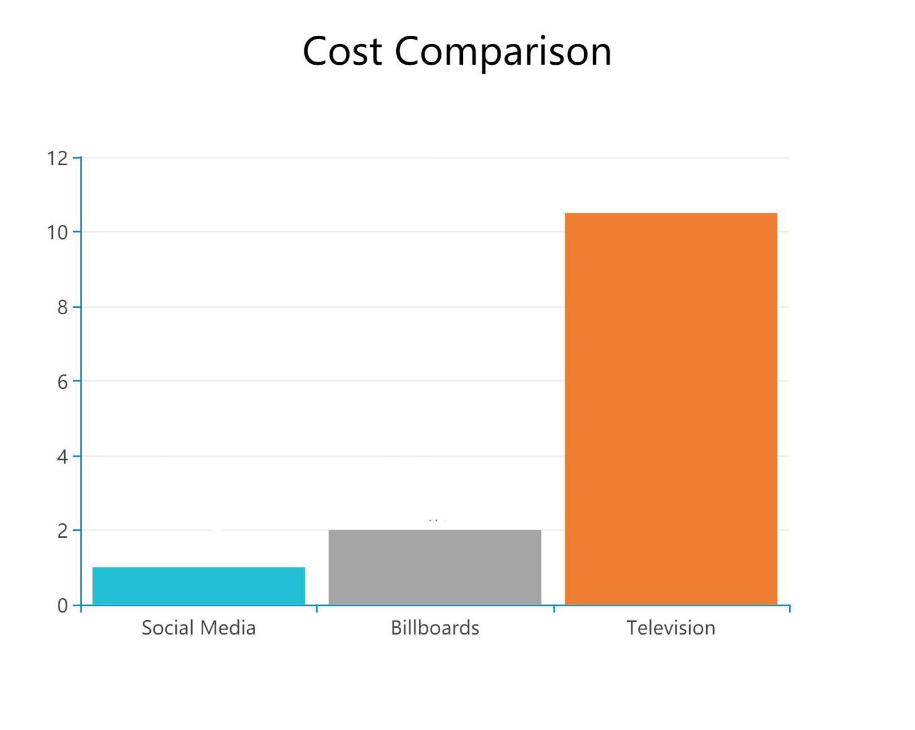


Implementation: Key steps and considerations
Marketing Expenditure
Key metrics and methods of analytics:
Social media has several methods of analytics, enabling user acquisition optimisation. For example, data suggests that posting and sharing between 1-3pm on weekdays generates the highest clickthrough rates for all platforms.
Considering its effectiveness, social media marketing is extremely cost-efficient. It is 2 times cheaper than billboards, and over 10 times cheaper than television marketing.
Primary analytics tools are:
Google Analytics
Facebook Analytics
Agora Pulse
Track KPIs such as clickthrough rates, event sign up rates and referral rates.
Analytics will enable 1Scope to tailor its social media campaign and maximise its effectiveness.
http://www.telegraph.co.uk/finance/newsbysector/mediatechnologyandtelecoms/digital-media/11597743/Teenagers-spend-27-hours-a-week-online-how-internet-use-has-ballooned-in-the-last-decade.html http://www.sciencedirect.com/science/article/pii/S1877042811015953
https://yump.com.au/2016-australian-mobile-statistics-how-digital-is-increasingly-a-mobile-first-experience/
Notes:
https://coschedule.com/blog/best-times-to-post-on-social-media/
https://blog.hootsuite.com/best-time-to-post-on-facebook-twitter-instagram/

Slide 18

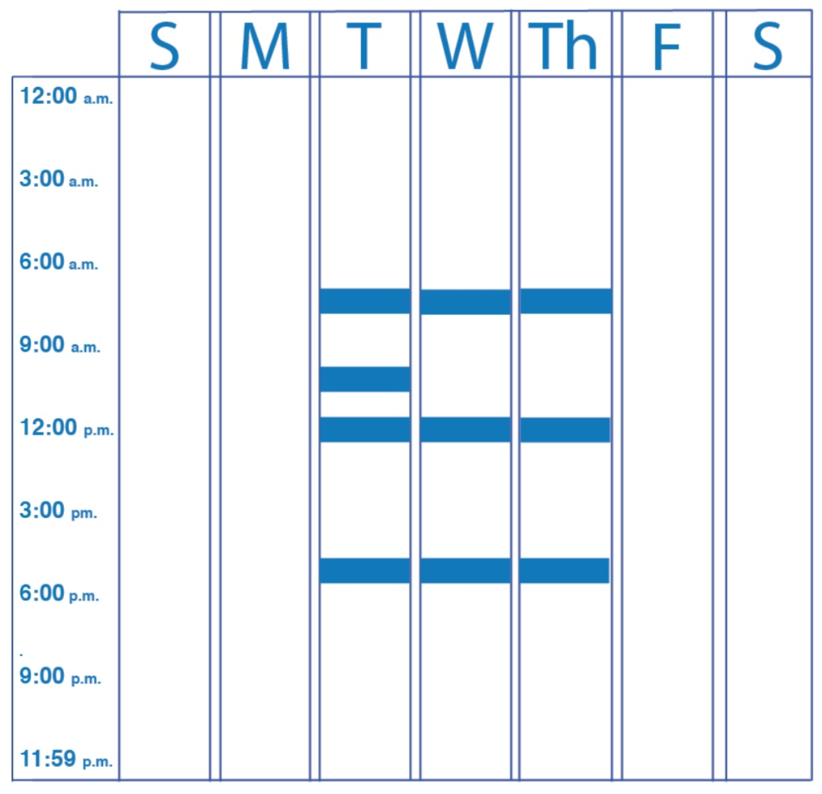
LinkedIn is a worthwhile social media marketing platform
Market Capitalisation
Implementation of LinkedIn Marketing
LinkedIn reaches 12% of Australian 18-29 year olds.
Analytics clearly suggest several key posting times
Posting on at midday on weekdays (Tuesday and Thursday) will generate the most interest and have the greatest impact.
Userbase likely to be seeking 1Scope’s value proposition.
Low cost, low effort implementation.
Posting is a multi-stage process:
Limitations
Content writing
Smaller reach than “mainstream social media”.
Link sharing
Lacking Facebook’s event management tool.
Visual media integration
http://www.telegraph.co.uk/finance/newsbysector/mediatechnologyandtelecoms/digital-media/11597743/Teenagers-spend-27-hours-a-week-online-how-internet-use-has-ballooned-in-the-last-decade.html http://www.sciencedirect.com/science/article/pii/S1877042811015953
https://yump.com.au/2016-australian-mobile-statistics-how-digital-is-increasingly-a-mobile-first-experience/
Notes:
https://business.linkedin.com/en-uk/marketing-solutions/blog/posts/B2B-Marketing/2016/Whats-the-best-time-to-post-on-LinkedIn

Slide 19












We’ve designed a 12-point posting plan for LinkedIn.
HEALTH
CAREER DEVELOPMENT
INTERVIEWS
NEGOTIATIONS
TRAVEL
STUDYING
NETWORKING
TIME MANAGEMENT
MARKETING
BRAND DEVELOPMENT
EXAM ADVICE
ENTREPRENEURSHIP
Notes:
81% of consumers use FB on their smartphone
Flow is an audience-targeting tool by Driftrock designed to sync with your existing CRM or ecommerce platform and pull in customer data that will help you target your existing customer base more fully and accurately. You can focus on your existing customers and mailing list, or find new people who share similar characteristics with your current customer base and uncover new leads and prospects.
Google Analytics is mainly a tool to track web traffic, but if you aren’t using it in conjunction with your Facebook marketing campaign, you’re missing out. Here, you’ll be able to see exactly which links brought Facebook users to your site, and what they did when they got there. It’s perfect for uncovering your true ROI and determining the effectiveness of your website layout.
Real Geeks’ Facebook marketing tool was developed with real estate agents in mind. The tool syncs with an external website, draws in key pieces of information to create new Facebook ads on the fly, and saves all the time that would ordinarily be spent mostly in the manual labor of ad creation. It also has a number of analytic functions, so users can determine which ads are most effective … and tailor their future strategies accordingly.
Agora Pulse is a suite of tools in one that give you the chance to tie your Facebook, Twitter, Google+, Instagram, and LinkedIn accounts into one centralized location. You can schedule and publish posts, monitor social activity, engage in social listening, and even monitor your competitors.
Social Bakers is a social analytics app that works with almost any social media app you can think of. It will bring you competitive research, audience insights, KPIs, and other social data in customized reports you can tailor to your specific goals.
DrumUp is a combination content marketing and social media tool that helps you find the most appropriate and effective content topics your audience would appreciate. It functions as a content research and recommendation tool, in addition to giving you key insights about your social media strategy in general.
Likealyzer is a tool that empowers you to analyze the reach and effectiveness of your Facebook page. Plug in the URL of your page and the tool will tell you what, if anything, is wrong with your layout, and what kind of activity your page is seeing. Best of all? It’s free.
ShortStack is designed to make the ad and contest creation process easier for Facebook and other social media platforms. It features a friendly UI and dozens of tools to help you create the campaign you need.

Slide 20
1Scope should pursue sign up strategies which will be consistent and include connection to the brand
Develop
‘Big Moment’ Marketing
Systematic Social Media
On Campus Marketing
Target students during the key moments of their lives
A consistent social media strategy aligns with student habits.
Increase 1Scope’s brand presence on university campuses.
New Product Offerings
1Scope Run Events
New products could appeal to different market segments
1Scope run events will increase interest and signups.
Renew
Partnership Strategies
Connect B2B to provide students with even better opportunities.

Slide 21
On campus marketing - Game Plan
Game Plan
1
Expand existing presence
Summer internships, how to guides,
High school information sessions on how to choose universities
2
Ambassadors
Open, push for during workshops
Recruit ambassadors before O-Week, lots of students have nothing to do in late January
3
Event offering expansion
Before O-Week begins
Expand events offered relevant to target geographic regions and schools
4
Spread merchandise, run class crash courses “essentials”, partner with as many uni societies as possible to use platform as signup platform
O-Week
Before O-Week begins
5
Sustained presence
Target big moments
Uni societies will use platform for career dev event signups. Sustain event offerings and on campus presence throughout the year
Notes:
UOQ – 5-7th Dec, OWEEK – 12th Feb – 16th
http://www.uq.edu.au/events/calendar_view.php?category_id=16&year=2018&month=&day=01
QUT – 2nd to 17th Nov – OWEEK 12th Feb – 16th
https://www.qut.edu.au/about/key-dates-and-academic-calendar/academic-calendar/2018-academic-calendar#h2-0
Griffith – 4th Dec, OWEEK 19th – 23rd Feb
https://www.griffith.edu.au/__data/assets/pdf_file/0005/904343/2017-Academic-Calendar.pdf

Slide 22




On campus marketing - Justification of methods
Ambassadors
O-Week
Lecture Bashing
Expos/Workshops
Low cost, somewhat skilled labour force with highest connections and reach
No legal requirements
Establish as campus norm
Thousands of curious, keen users
Host “essentials” workshops
Giveaway merchandise, business attire
Captive audience, direct target market of interested users
800 students per lecture
Lecturer endorsed
Direct target audience who are guaranteed to be on the lookout for career opportunities
Place to personally connect with students
November– January 17’
Feb 18’
March 18’
April 18’ onwards
Notes:
70% more likely to attend if on campus

Slide 23

On campus marketing - Step 1 and 2
1
2
Expand existing presence
Goal:
Create awareness
Ambassadors
Establish as norm before university begins
Proposal:
Workshops at exam end
“Jobs during the summer”
Workshops late January
“Essentials for XXX students”
“Essentials for Commerce students”
“How to choose uni classes”
BSoc camp equivalent
Ambassadors
Goal:
Low cost labour resource
Leverage student connections
Proposal:
Open recruitment until late January
Trained early February
Ready for O-Week and lecture bashing
Provide with professional training and experience
Semester terms
Notes:
UOQ – 5-7th Dec, OWEEK – 12th Feb – 16th
http://www.uq.edu.au/events/calendar_view.php?category_id=16&year=2018&month=&day=01
QUT – 2nd to 17th Nov – OWEEK 12th Feb – 16th
https://www.qut.edu.au/about/key-dates-and-academic-calendar/academic-calendar/2018-academic-calendar#h2-0
Griffith – 4th Dec, OWEEK 19th – 23rd Feb
https://www.griffith.edu.au/__data/assets/pdf_file/0005/904343/2017-Academic-Calendar.pdf

Slide 24
On campus marketing - Step 3 and 4
3
4
Expand event offering
Goal:
Increased signups and usage
Proposal:
Sign on more companies, invite key people to workshops
Partner with university societies, 1Scope as their ticketing platform for all things career development related
Host events that target higher years (e.g. internship application during Feb)
O-Week
Goal:
Establish as campus norm
Maximise on campus, personal exposure
Distribute merchandise
Proposal:
Ambassadors to man booths
Host specific workshops with societies e.g. “Fundamentals of Commerce”, “First year maths essentials”
Merchandise distribution to get 1Scope brand across
Promote follow up events
Giveaways
Notes:
UOQ – 5-7th Dec, OWEEK – 12th Feb – 16th
http://www.uq.edu.au/events/calendar_view.php?category_id=16&year=2018&month=&day=01
QUT – 2nd to 17th Nov – OWEEK 12th Feb – 16th
https://www.qut.edu.au/about/key-dates-and-academic-calendar/academic-calendar/2018-academic-calendar#h2-0
Griffith – 4th Dec, OWEEK 19th – 23rd Feb
https://www.griffith.edu.au/__data/assets/pdf_file/0005/904343/2017-Academic-Calendar.pdf

Slide 25
On campus marketing - Step 5
5
Sustained presence
Goal:
Enforce as campus norm
Target big moments
Ensure 1Scope used as platform for all things career related
Proposal:
Lecture bashing: First week, first year courses, ambassadors place flyers on seats and promote 1Scope through a relevant event, 1Scope as the signup process, promote on the spot signups e.g. if sign up now, event will be free
Must contact lecturer via email
Following on, target big moments, e.g. first exam periods to run workshops.
Ensure and enforce societies are using 1Scope as their ticketing platform for all career related events
Notes:
UOQ – 5-7th Dec, OWEEK – 12th Feb – 16th
http://www.uq.edu.au/events/calendar_view.php?category_id=16&year=2018&month=&day=01
QUT – 2nd to 17th Nov – OWEEK 12th Feb – 16th
https://www.qut.edu.au/about/key-dates-and-academic-calendar/academic-calendar/2018-academic-calendar#h2-0
Griffith – 4th Dec, OWEEK 19th – 23rd Feb
https://www.griffith.edu.au/__data/assets/pdf_file/0005/904343/2017-Academic-Calendar.pdf

Slide 26
1Scope should pursue sign up strategies which will be consistent and include connection to the brand
Develop
‘Big Moment’ Marketing
Systematic Social Media
On Campus Marketing
Target students during the key moments of their lives
A consistent social media strategy aligns with student habits.
Increase 1Scope’s brand presence on university campuses.
New Product Offerings
1Scope Run Events
New products could appeal to different market segments
1Scope run events will increase interest and signups.
Renew
Partnership Strategies
Connect B2B to provide students with even better opportunities.

Slide 27





1Scope can expand its range of opportunities to attract more signups and increase user engagement.
Outside curriculum
Skills unassociated with education systems which add value to students
1Scope currently offers:
Extra-curriculum
Activities offered to supplement student education and growth.
Core curriculum
Enrichment programs to complement the core school curriculum and university courses
1. Research
Most sought after activities and discovering student needs and wants
2. Sourcing
Relevant institutions, groups and associations to provide opportunities
3. Advertising
Offer new and broader range of opportunities on their website
4. User acquisition
Increase users from a different demographics through better user engagement
Notes:
Outside the curriculum - Relevant activities, tasks and hobbies which would increase value to a person professionally
Extra-curriculum
Core curriculum

Slide 28
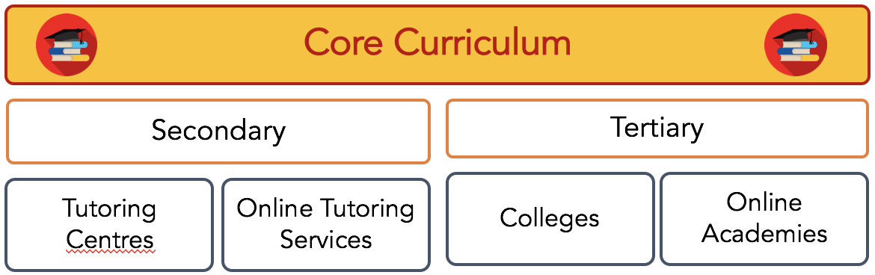

Proposal of offerings to be provided by 1Scope
New product
Types of new product offered
Sources for these products
Outside Curriculum
New product
Arts and Fine Arts
Sports
Performing Arts
Additional skills and certificates
Travel, Exploration
Types of new products offered
Art Schools, Language Schools
Sport Associations, Gyms, Clubs
Performing Arts Schools, Musical acts and groups
Online Academies, Colleges
Exchange Programs, DOE, Scouts
Sources for these products

Slide 29
1Scope should pursue sign up strategies which will be consistent and include connection to the brand
Develop
‘Big Moment’ Marketing
Systematic Social Media
On Campus Marketing
Target students during the key moments of their lives
A consistent social media strategy aligns with student habits.
Increase 1Scope’s brand presence on university campuses.
New Product Offerings
1Scope Run Events
New products could appeal to different market segments
1Scope run events will increase interest and signups.
Renew
Partnership Strategies
Connect B2B to provide students with even better opportunities.

Slide 30
Hack-a-thons are labour and cost-efficient events which align with 1Scope’s value proposition
When?
Summer break (Dec-Feb)
Winter break (June-July)
1Scope headquarters
Where?
Crash Courses and Intensive holiday programs
Workshops
Competitions
Implementation
Free for 1Scope members
Ticketed event allowing for 40 participants per session
Recruitment of mentors for workshop facilitation and to create a more intimate learning environment
Junior and Senior Divisions
Cost?
How?

Slide 31



Hack-a-thons are labour and cost-efficient events which align with 1Scope’s value proposition
Strong appeal to student interests and desire to obtain highly relevant skills in the digital age
Highly cost and labour efficient
Will it work?
Why are we recommending it?
Aligns with 1Scope’s value proposition of providing students with access to value-adding opportunities
Contributes to a unique branding of the company
Labour and cost efficiencies enable 1Scope to work within current resource limitations
Justification
What do we have to consider?
Term dates of schools and universities
Further incentivising potential mentors to join the ambassador program
Areas of popular student interest

Slide 32
1Scope should run events which align with student interests beyond the traditional curriculum
Science & Social Sciences
Business: solving real-life managerial cases
Technology
Computer programming: incorporating coding and java techniques to develop unique product solutions
Engineering
Modelling: top projects are connected with professionals for experimentation and practical application
Mathematics
Data analysis: working towards data-based solutions
Not-for-
profit
Public Sector
HACKATHONS
STEM
Private Sector

Slide 33
1Scope should run low-cost and non labour-intensive events which offer non-traditional opportunities
Meet
the Team
Low cost and minimally labour-intensive alternative providing students with networking opportunities in the start-up field. Event run contingent on the availabilities of the 1Scope team.
Start
a
Start-up
Providing students with opportunities for students with start-up ideas to be mentored by professionals in the industry
1Scope Tours
Fun and leisurely activity for students to learn about 1Scope’s background and tour the company headquarters

Slide 34

Renew

Slide 35
1Scope should pursue sign up strategies which will be consistent and include connection to the brand
Develop
‘Big Moment’ Marketing
Systematic Social Media
On Campus Marketing
Target students during the key moments of their lives
A consistent social media strategy aligns with student habits.
Increase 1Scope’s brand presence on university campuses.
New Product Offerings
1Scope Run Events
New products could appeal to different market segments
1Scope run events will increase interest and signups.
Renew
Partnership Strategies
Connect B2B to provide students with even better opportunities.

Slide 36



Partnership strategies can be focused onto smaller, specific targets for consistent return.
1Scope’s value proposition for businesses
How to target
1
Target emailing campaign
Opportunity posting
Personalised marketing for eg. tutoring centres
Parents and students
Evaluation will reflect student experience and learnings
2
Evaluation component
Useful data for future learning focusses
Principals
Partner with societies to create academic and social events
3
Event management
Introduce specific course revision during exam times
Target the timeline of events for students for eg. internship seaso, exam period
Societies and their students

Slide 37
From criteria we developed to assess overall compatibility of certain partners, 1Scope should partner with university societies
Steps to create a partnership
 | Tutoring Centres (Dr Du) | Big 4 (KPMG, Deloitte, PwC, EY) | NFP (Ozharvest, Mission Australia, Fred Hollows) | Societies (UNSW Business Society, UNSW Engineering Society)
Brand image (15%)
Willingness to partner (20%)
Engagement with market (40%)
Vision, design and cultural alignment (25%)
Overall ranking | 3 | 2 | 4 | 1
1
Analyse partnership under criteria
2
Identify and choose potential partners with best fit
3
Initiate contact through a personalised email or phone call
Upon mutual interest, 1 on 1 discussion on contract and event proposals
4
5
Agreements are made officially with signing of contract

Slide 38







1Scope’s offerings align and fit well with society offerings
Society offerings
1Scope’s offerings
Exposure to broad student base
Able to connect students with more professionals
Need identification and understanding
Resources such as venue and refreshments
Willingness to create events which align with vision of growing students
Willingness to help societies create events which grow students
Positive brand association and extensive reach
An accessible platform where societies can post their events for all users to expand reach
Notes:
Partnership – how to incentivise universities to run more events for you
What value would we give them?
We need to pitcht o christina that we have an online impact – have recuring events so that students within the society are aligned with 1Scope
Christina can bring speakers and connections – benefits of partnersihp vs. one off ad hoc
Issue right now: 1scope is the middle man make it useful and have added value throguh 1scope – incentivise people to run events
1scopes strength – have speakers and contacts and then provide venue

Slide 39

Impact

Slide 40



1Scope should consider some possible aspects of development moving forward
Implementation
Detailed implementation plants could require physical solutions and to be implemented first.
Risk Mitigation
Ensuring that strategies are properly planned before execution will not result in wasted time and money.
Feedback
1Scope should aim to gather metrics on how strategies are working to refine them continuously

Slide 41
Implementation Timeline and KEY DATES
2017 NOV | DEC | 2018 JAN | FEB | MAR | APR | MAY
1
Develop execution strategies
Pilot
Evaluate
Amend
Roll Out
2
Refine
Implement
Ongoing Evaluation
Tailor
Roll Out
Expand existing presence
Ambassadors
Expand event offering
O-Week
Sustained presence
3
4
Research
Source
Advertise
Evaluate
Amend
Develop execution strategies
Market Event
Mentor Recruitment & Training
Pilot
Roll Out
5
Evaluate
Amend
6
Discussion with potential partners
Official event proposals & discussions post contract
Planning for first event
Evaluate and analyse
Continuance of partnership

Slide 42
Risks unique to each strategy must be recognised and appropriately mitigated.
 | Risk | Mitigation
Big Moment | 1scope has the wrong event for the moment | 1scope can conduct more market research on what key moments are and redevelop their workshops to better address key moments
 | People don’t associate 1scope with their moments | Having more frequent workshops and a better online connection will ensure 1scope is there from start to finish of a student's life (from 12 -25).
Systematic social media | Marketing content may be poorly managed. | Closely monitor 1Scope’s posts and content, as well as audience perception.
 | Social media accounts can be breached. | Ensure necessary security protocols are taken, such as two-step login processes or multiple administrator post approval.
On campus marketing | Ambassadors convey the wrong message to students | Really ensure they are trained and educated with the values, vision and purpose of 1Scope has to offer.
 | Universities and societies already hosting workshops | This is why it is essential to partner up with university societies. It doesn’t have to be in conjunction with 1Scope - as long as they use your platform for ticketing, you still get the sign ups.
New product offerings | Lack of sourcing to allow new opportunity offerings | Try different sectors and organisations and tweak agreements to better suit each their needs
 | Conflict of small team taking on greater work | Implementation of Ambassadors program to assist in sourcing new opportunities to ensure current initiatives don’t lose momentum
1Scope run events | Lack of student interest in taking on mentorship and facilitator-related positions | Appropriately incentivising opportunities and ensuring they align with the magnitude of the task asked of them
 | Event run requiring greater costs and labour than anticipate | Working within a strict budget and anticipating disruptions regarding access to event locations and the availability of 1Scope representatives to be presesnt
Partnership strategies | Emails do not resonate with potential partner | Draft emails with significant understanding of potential partner’s business
 | Lack of communication | Set up communication expectations upon commencement of partnership
Notes:
recognising the problem of conflict of small team and the hard work of sourcing these opportunities - but can be mitigated by ambassadors - cannabilism

Slide 43






We are have developed measures of impact.
We have identified three qualitative outcomes for success:
Student understanding of 1Scope’s value proposition.
Student satisfaction with service provided.
Likelihood to refer to a friend.
The long term success of the strategy will be defined and measured by several key KPIs that we are currently developing:
User Acquisition
Tracking userbase growth in comparison with strategy milestones.
User Engagement
Understanding of 1Scope’s value proposition, tracking event attendance.
Cost Analysis
Meeting or beating 1Scope’s stated budget of $3 per acquired user.
Retention & Referral
Implementing a measure of how many students sign-up through referrals.

Slide 44
1Scope should consider some possible aspects of development moving forward
1
Test recommended strategies on a small scale to prioritise efforts
2
Revamp existing website in order to cut costs and increase accessibility
3
Upscaling current and new strategies to operate nationally.
4
Create a well-defined feedback system increase operational efficiency
Potential area to focus on within the next 6-12 months

Slide 45

Appendix

Slide 46
Solution feasibility table
SOLUTION | Premise/details | Relevant Costs | Manpower | Technical difficulty | Planning required
Big Moment | 1scope will create events specifically catered towards impactful moments in a student's life | Low | Med | Med | Med
Systematic social media | Use of structured marketing campaigns across social media platforms to push 1Scope’s brand and events. | Low | Low | Med | Med
On campus marketing | Establishing 1Scope as campus norm by increasing on campus presence through ambassadors | Low | High | Med | High
New product offerings | Expand the range of opportunities offered by 1Scope to include outside curriculum and core curriculum activities | Low | Med | Low | Med
1Scope run events | 1Scope should run events offering non-traditional learning opportunities and experiences | Low | Med | High | High
Partnership strategies | Forming formal partnerships university societies allows 1Scope to leverage their society base to increase users | Low | High | Low | High

Slide 47



Giveaway offers can be aligned with 1Scope's value proposition
Previous giveaway strategy
New strategy
Fitness First
Business Attire
Stationary
Whitehouse Vouchers
Card Holders
Coffee cup discounts
There is a disconnect between 1scope’s between 1scope’s giveaways and 1scope’s value proposition
Focusing on user engagement and creating more valuable merchandise will connect users to 1scope

Slide 48



Case Study: OrgSync
Founded in 2007 as a way for student societies and clubs to organise everything in an all in one platform.
By providing their services during key organisational moments such as AGM’s and event management they have grown to service over 3.5million members
Arc@UNSW was founded in 2006 and has transitioned into using Orgsync to organise all important club information and events into one location.
Orgsync has positioned themselves as the premier, all in one organisational tool for all clubs and society management around the world.
Source:Orgsync.com

Slide 49













Outside curriculum opportunities is a value-added for any resume.
Resumes reflect the person. In addition to professional skills, they also need character. These outside curriculum opportunities are recommended because they show:
PERSONALITY
Positive qualities
BRANDING
Unique offerings
PASSION
Interest for the job
YOGA
Calm, in control
BLOGGING
Writing skills, reflection of
persona
FANTASY FOOTBALL
Interest in venture capital,
calculated risk-taker
CHESS
Intelligence, strategic
PHOTOGRAPHY
Creativity, positioning,
patience
GARDENING
Interest in sustainability,
clean energy
ENDURANCE SPORTS
Drive, tenacity,
determination
VIDEO PRODUCTION
Event planning, precise,
highly-focussed
HIKING
Interest and experience in travelling
TEAM SPORTS
Team player, cooperation
Captain (leadership)
OTHER
Uncommon activities
which can lead to
interesting conversations
MUSICAL INSTRUMENT
Focus, dedication,
discipline
WEBSITE CREATION
Coding/software skills
SOURCES
smh.com
cvplaza.com

Slide 50




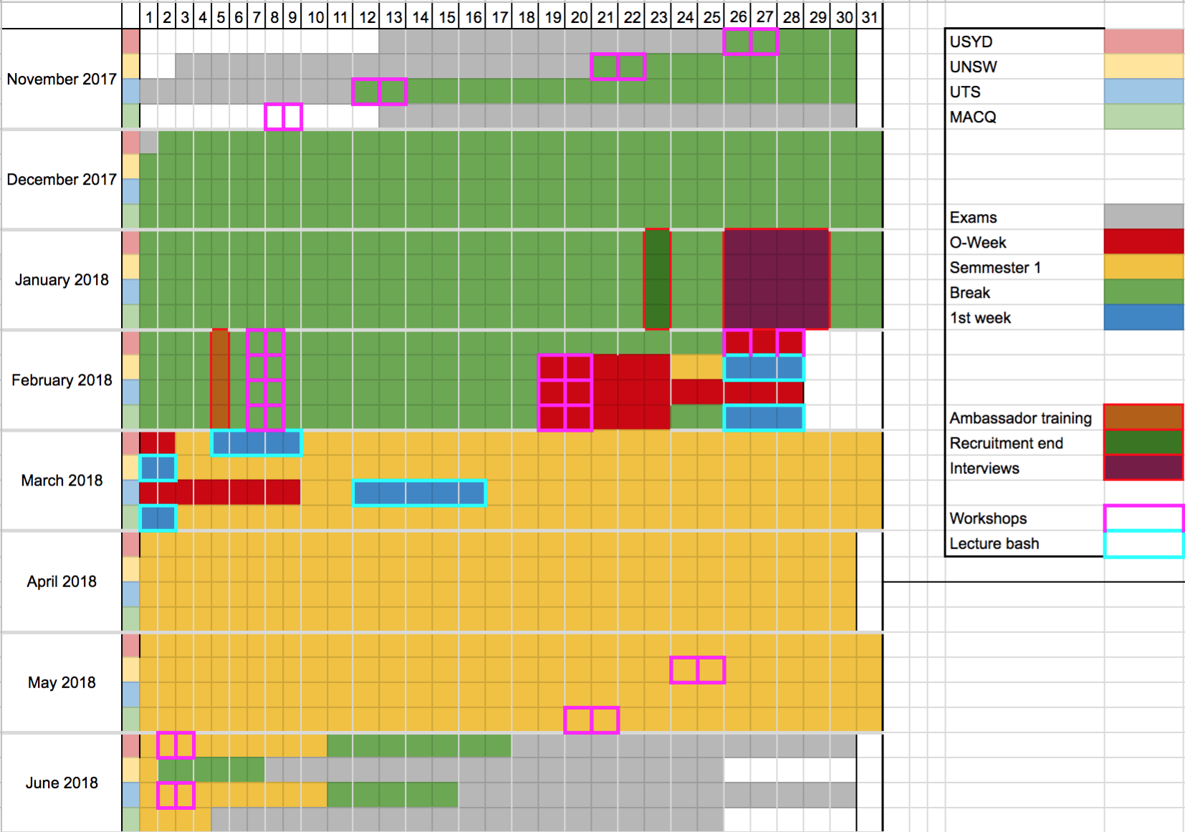
Australia domination - NSW
UNSW
ECON1101 http://classutil.unsw.edu.au/ECON_S1.html#ECON1101T1
FINS1613 http://classutil.unsw.edu.au/FINS_S1.html#FINS1613T1
FINS2624 http://classutil.unsw.edu.au/FINS_S1.html#FINS2624T1
ACCT1501 http://classutil.unsw.edu.au/ACCT_S1.html#ACCT1501T1
MATH1131 http://classutil.unsw.edu.au/MATH_S1.html#MATH1131T1
COMP1511 http://classutil.unsw.edu.au/COMP_S1.html#COMP1511T1
ENGG1000 http://classutil.unsw.edu.au/ENGG_S1.html#ENGG1000T1
Notes:
UOQ – 5-7th Dec, OWEEK – 12th Feb – 16th
http://www.uq.edu.au/events/calendar_view.php?category_id=16&year=2018&month=&day=01
QUT – 2nd to 17th Nov – OWEEK 12th Feb – 16th
https://www.qut.edu.au/about/key-dates-and-academic-calendar/academic-calendar/2018-academic-calendar#h2-0
Griffith – 4th Dec, OWEEK 19th – 23rd Feb
https://www.griffith.edu.au/__data/assets/pdf_file/0005/904343/2017-Academic-Calendar.pdf
RMIT
https://www.rmit.edu.au/students/student-essentials/important-dates/higher-education-important-dates/2017-higher-education-important-dates
Monash
https://www.monash.edu/students/dates/summary-dates
Melb
http://www.unimelb.edu.au/dates?queries_year_fquery=next_year

Slide 51



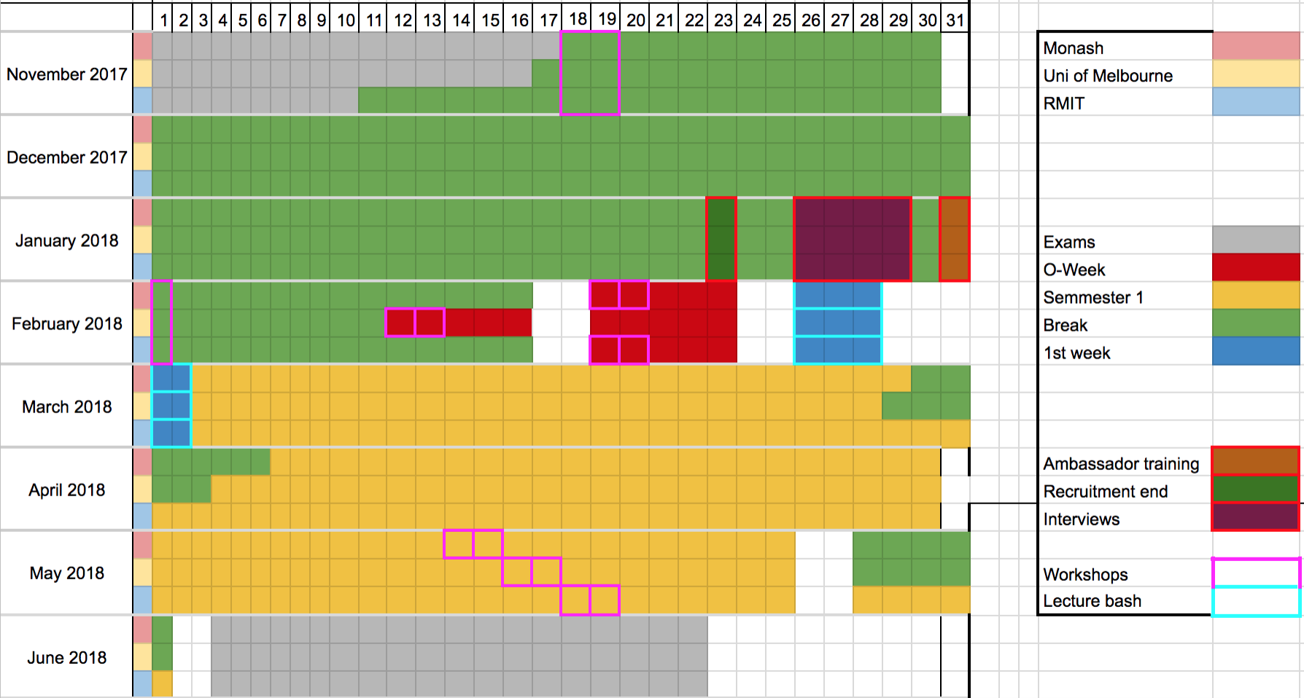
Australia domination - Victoria
Notes:
UOQ – 5-7th Dec, OWEEK – 12th Feb – 16th
http://www.uq.edu.au/events/calendar_view.php?category_id=16&year=2018&month=&day=01
QUT – 2nd to 17th Nov – OWEEK 12th Feb – 16th
https://www.qut.edu.au/about/key-dates-and-academic-calendar/academic-calendar/2018-academic-calendar#h2-0
Griffith – 4th Dec, OWEEK 19th – 23rd Feb
https://www.griffith.edu.au/__data/assets/pdf_file/0005/904343/2017-Academic-Calendar.pdf
RMIT
https://www.rmit.edu.au/students/student-essentials/important-dates/higher-education-important-dates/2017-higher-education-important-dates
Monash
https://www.monash.edu/students/dates/summary-dates
Melb
http://www.unimelb.edu.au/dates?queries_year_fquery=next_year

Slide 52



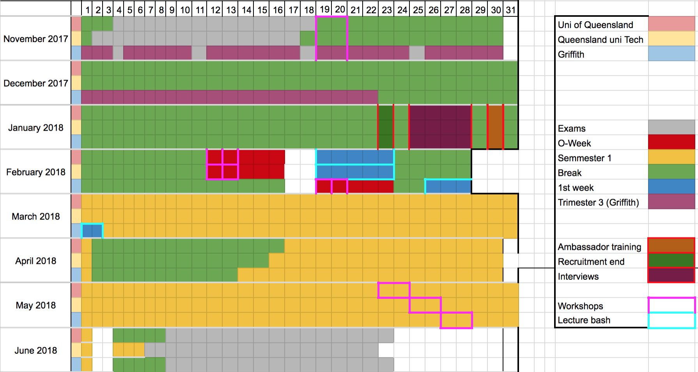
Australia domination - Queensland
Notes:
UOQ – 5-7th Dec, OWEEK – 12th Feb – 16th
http://www.uq.edu.au/events/calendar_view.php?category_id=16&year=2018&month=&day=01
QUT – 2nd to 17th Nov – OWEEK 12th Feb – 16th
https://www.qut.edu.au/about/key-dates-and-academic-calendar/academic-calendar/2018-academic-calendar#h2-0
Griffith – 4th Dec, OWEEK 19th – 23rd Feb
https://www.griffith.edu.au/__data/assets/pdf_file/0005/904343/2017-Academic-Calendar.pdf
RMIT
https://www.rmit.edu.au/students/student-essentials/important-dates/higher-education-important-dates/2017-higher-education-important-dates
Monash
https://www.monash.edu/students/dates/summary-dates
Melb
http://www.unimelb.edu.au/dates?queries_year_fquery=next_year

Slide 53
Appendix B1: Surveys were distributed to high school and university students.
Surveys were chosen because:
Best for quantitative data
Non-personal, anonymous but can target large, varying audience
Time and cost efficient
Surveys were designed to test:
Demand
Accessibility
Supply
Alternatives
Surveys were distributed to through facebook:
To university students
To HSC students
To friends and family aged 12-25
The survey distributed to university students received 102 responses.
The survey distributed to high school students received 38 responses.

Slide 54
Appendix B2: University Survey
How aware are you of the personal and professional benefits of external opportunities for university students?
How often do you see a career related event advertised?
Where have you seen/heard these opportunities?
How interested are you in attending career related events?
Have you attended any events the last 6 months?
If you answered yes, what events do you usually go to?
What captures your first interest to go to a career related event when you see it online?
How satisfied are you with the experience given?
How convenient did you find it to attend the event?
Would you be more likely to attend an event either:
What opportunities interest you the most?
Other than the options in question 11, what else would you like to see
Do you feel connected, aware and informed enough about opportunities?
How you be interested in a consolidated platform for uni, career specific opportunities (similar to seek.com)
What year of study are you in?
What faculty are you in?

Slide 55
Appendix B3: High School Survey
Are you aware of external career related opportunities for high school students?
How often do you see a career related event advertised?
How interested are you in attending career related events?
Have you attended any events in the last 6 months?
How satisfied are you with the experience given?
How convenient did you find it to attend the event?
Would you more likely to attend a career related event either:
What opportunities interest you the most? (Please select more than one option if applicable)
Other than the options in question 8, what else would you like to see
What year are you in?
What school do you go to?
What is your sex?

Slide 56
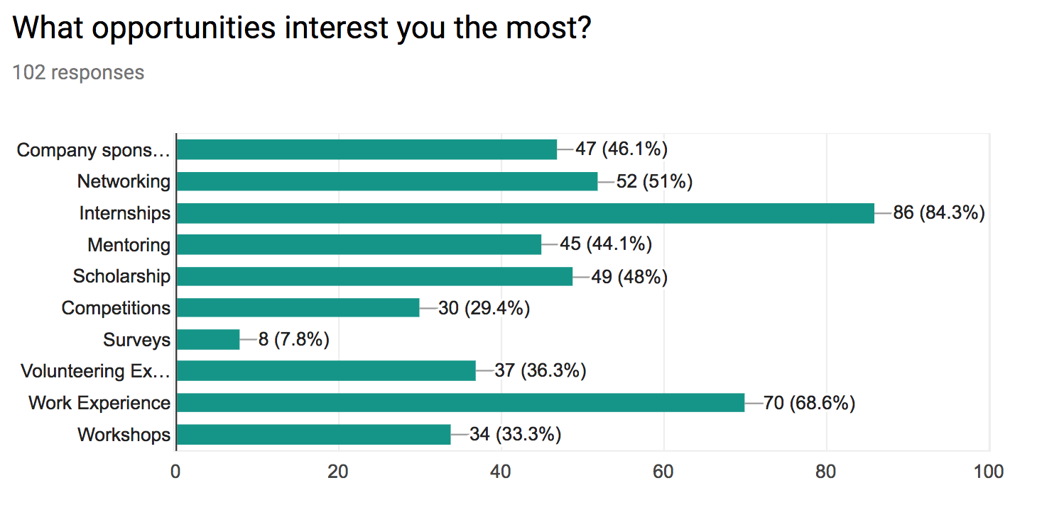
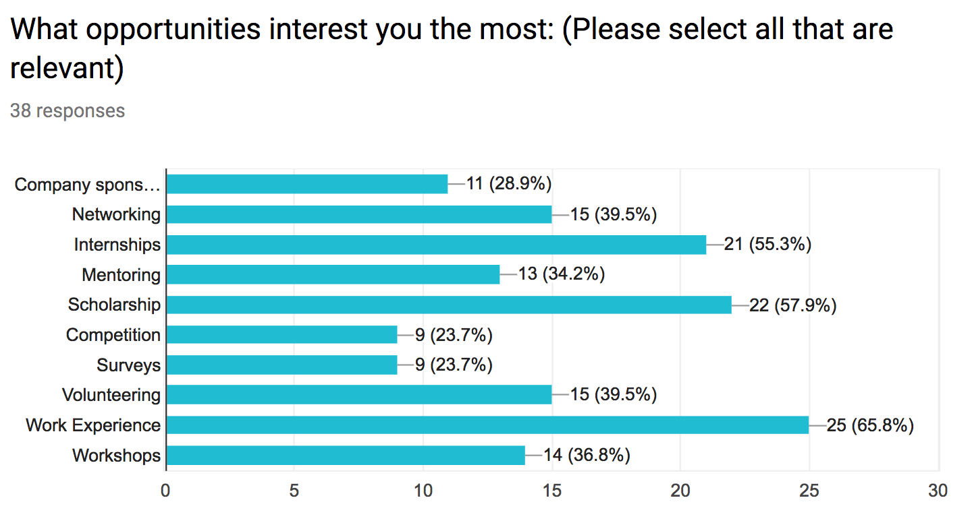
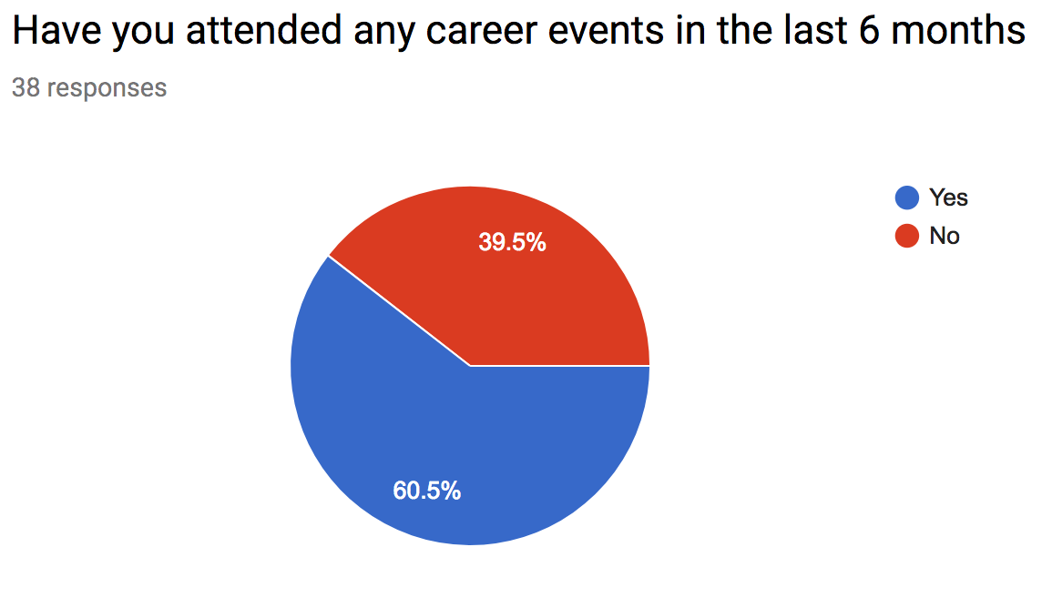
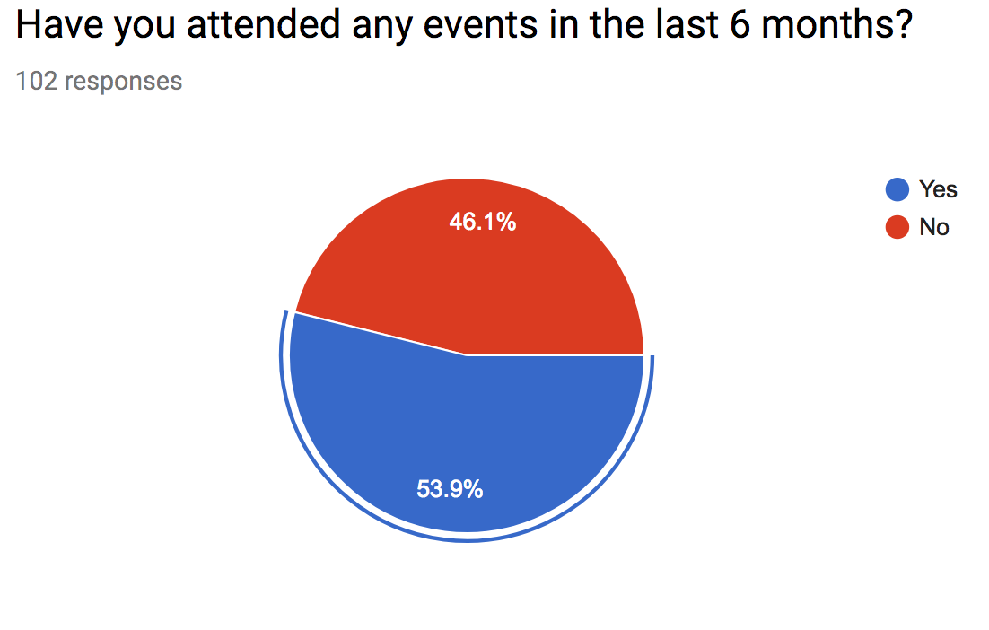
Appendix C1: Survey results - users want to feel connected
SOURCES
Uni: https://goo.gl/forms/xJfYBNZwSqI0V2gR2
HS: https://goo.gl/forms/4dDN8pntGEMRk90w2

Slide 57
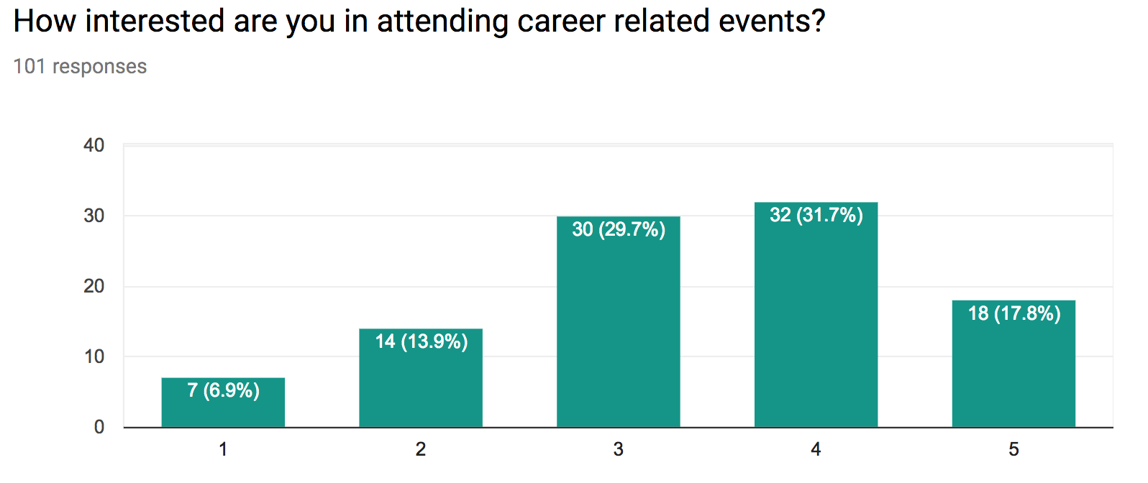
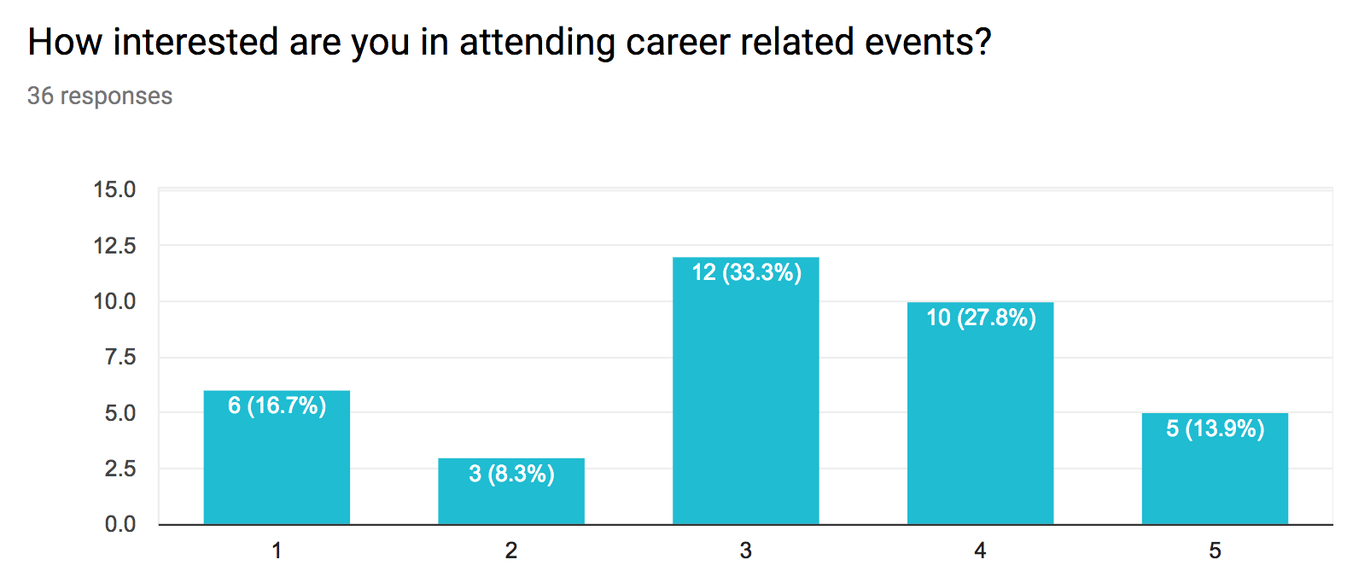
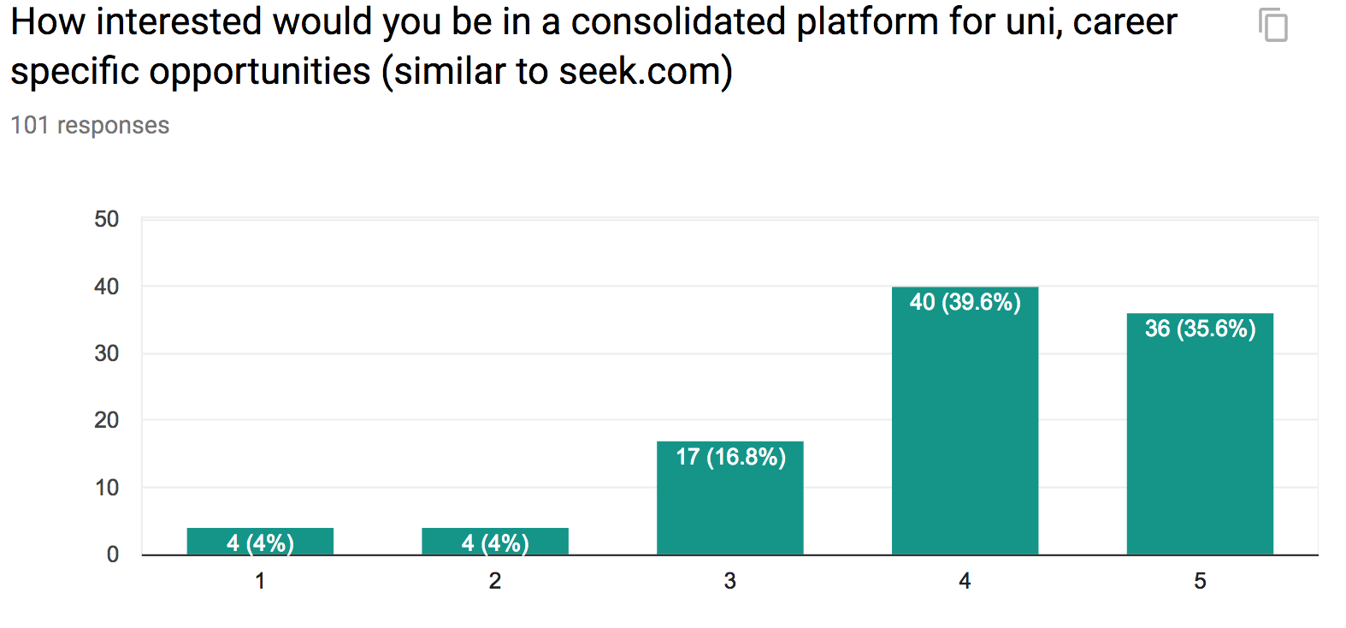
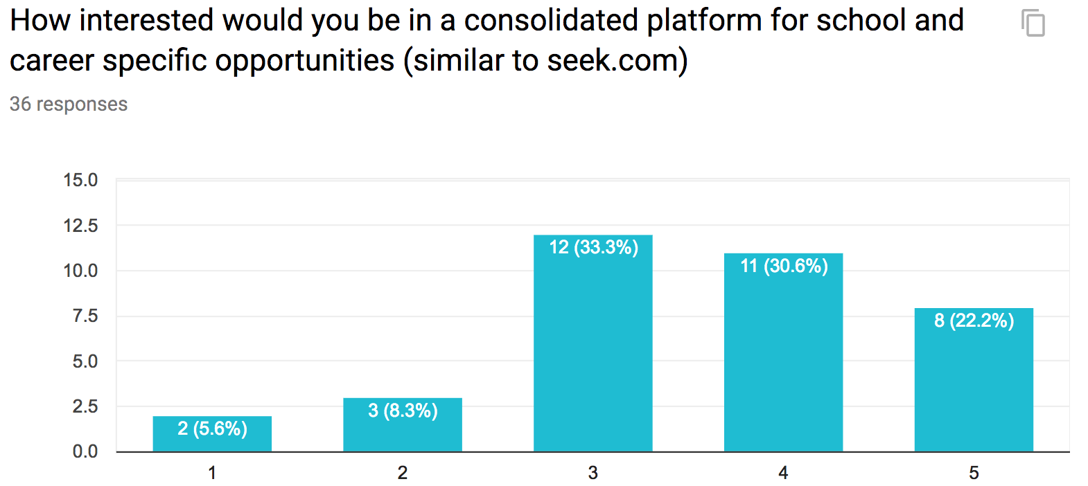
Appendix C2: Surveys demonstrates that users want to feel connected, would seek x, y, z
Uni students
Company association 40.6%
Society run 50%
3 out of 5 ease of finding event
70% more likely to attend if on campus
HS students
Interested in scholarships 58.3%
3 out of 5 ease of finding event
44% more likely to attend if on campus, 33% don’t care
SOURCES
Uni: https://goo.gl/forms/xJfYBNZwSqI0V2gR2
HS: https://goo.gl/forms/4dDN8pntGEMRk90w2

Slide 58
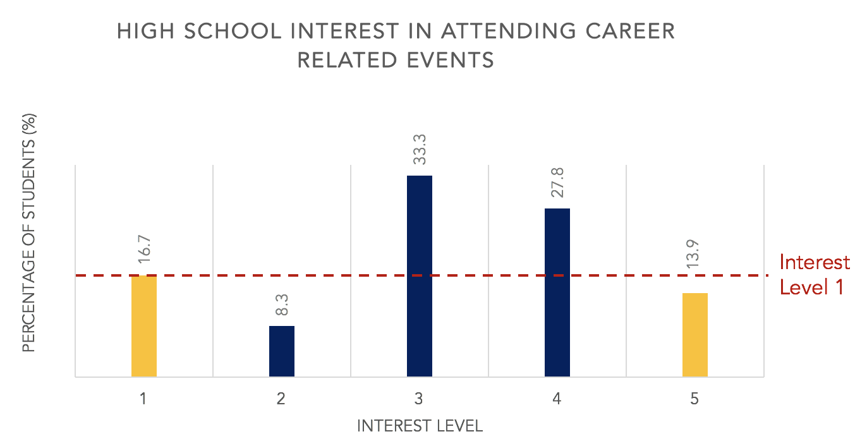
Appendix C3: High school survey statistics
Notes:
HS: There is a higher level of students disinterested in traditional career related events rather than super interested
UNI: out of the 10 types of opportunities offered, only 3 were above the half-way mark – others the average uni student wouldn’t be interested in
Greater range, greater alignment with student interest – closing the gap. Better user engagement – attract signups.
Make graphs in final slide!!!

Slide 59
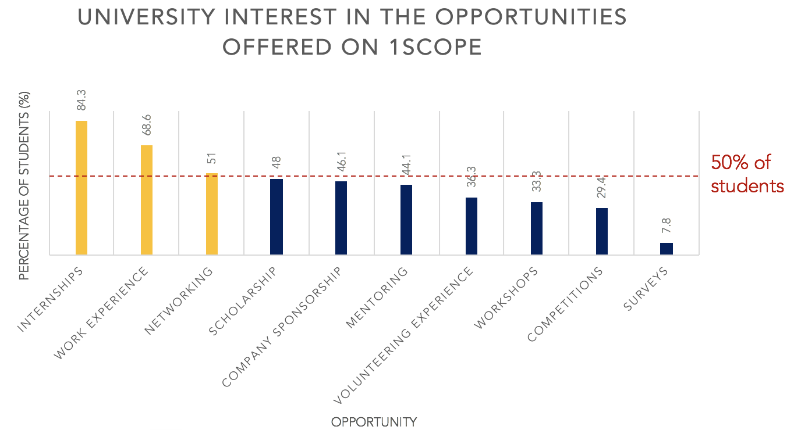
Appendix C4: University student survey
Notes:
HS: There is a higher level of students disinterested in traditional career related events rather than super interested
UNI: out of the 10 types of opportunities offered, only 3 were above the half-way mark – others the average uni student wouldn’t be interested in
Greater range, greater alignment with student interest – closing the gap. Better user engagement – attract signups.
Make graphs in final slide!!!

